Slide 1
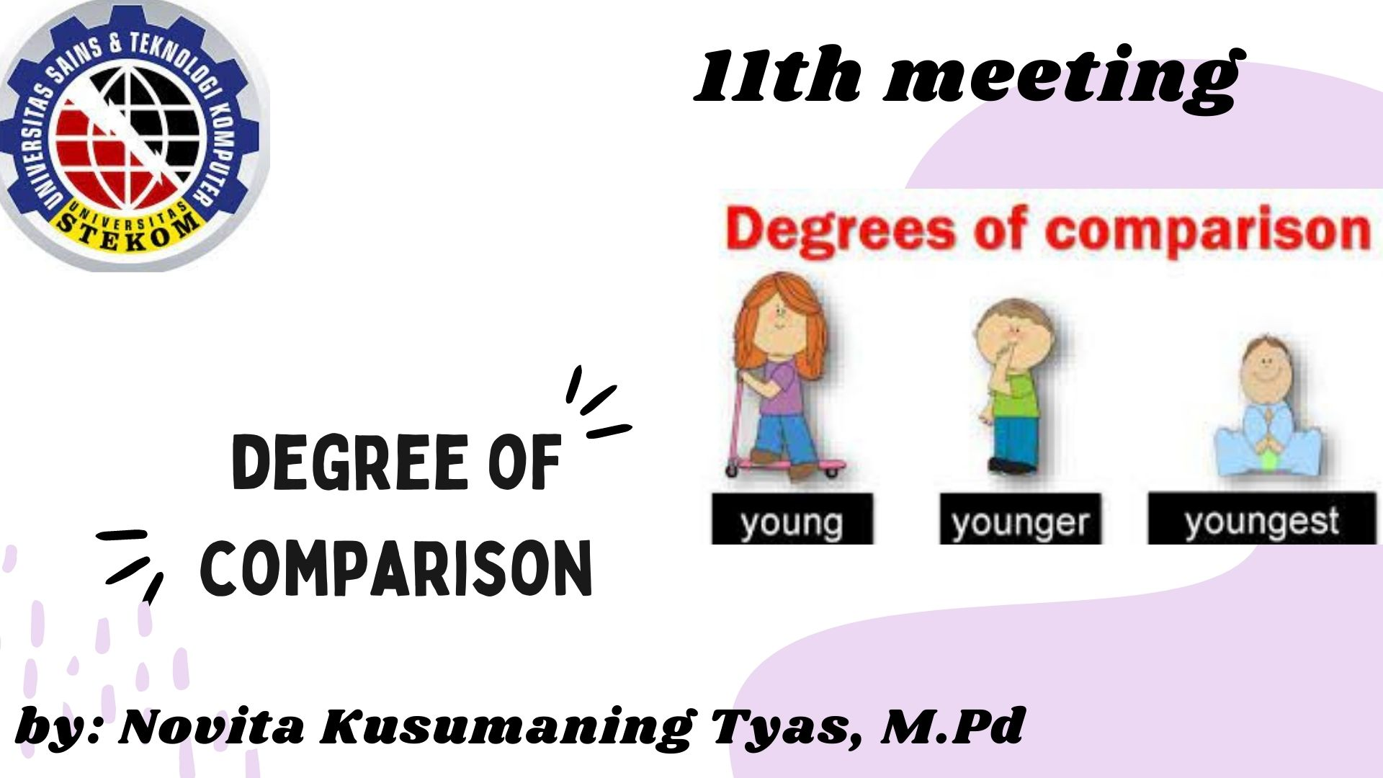

Slide 2
Degrees of Comparison is a kind of a comparison used to compare something with another thing or with the others using adjective to compare.
There are three ways you can compare adjectives
positive
comparative
superlative

Slide 3
1. Positive with as
The positive form is used in cases where there are no differences between the two compared things or persons. To form the positive, we use the word as before and after the absolute form of the adjective.
Martin is as tall as John.
She is as beautiful as her sister.
This can also be applied in a negative context to indicate that the compared objects are not similar:
Martin is not as tall as John.
She is not as beautiful as her sister.

Slide 4
2. Comparison – the basic rules
When two objects or persons are being compared, the comparative form of the adjective is used. The comparative adjective can be formed in two ways:
Adding –er to the absolute form of the adjective.
tall → taller → (the) tallest
Adding the word more before the adjective.
beautiful → more beautiful → cleaner → (the) most beautiful
Which one to use depends on the number of syllables in the adjective

Slide 5
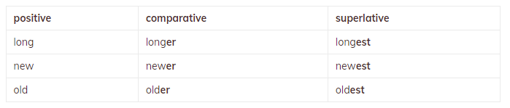
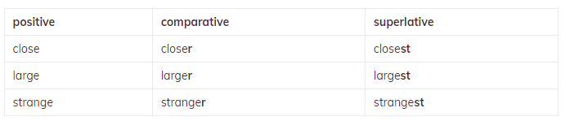
Adjectives with one syllable add -er and –est
Adjectives with one syllable ending in –e only add r and st

Slide 6
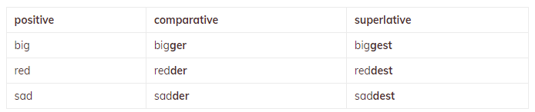
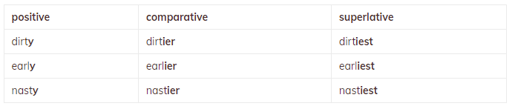
Adjectives with one syllable ending in a consonant with a single vowel before it double the consonant and add er and st
Adjectives with two syllables, ending in -y have ier and iest

Slide 7
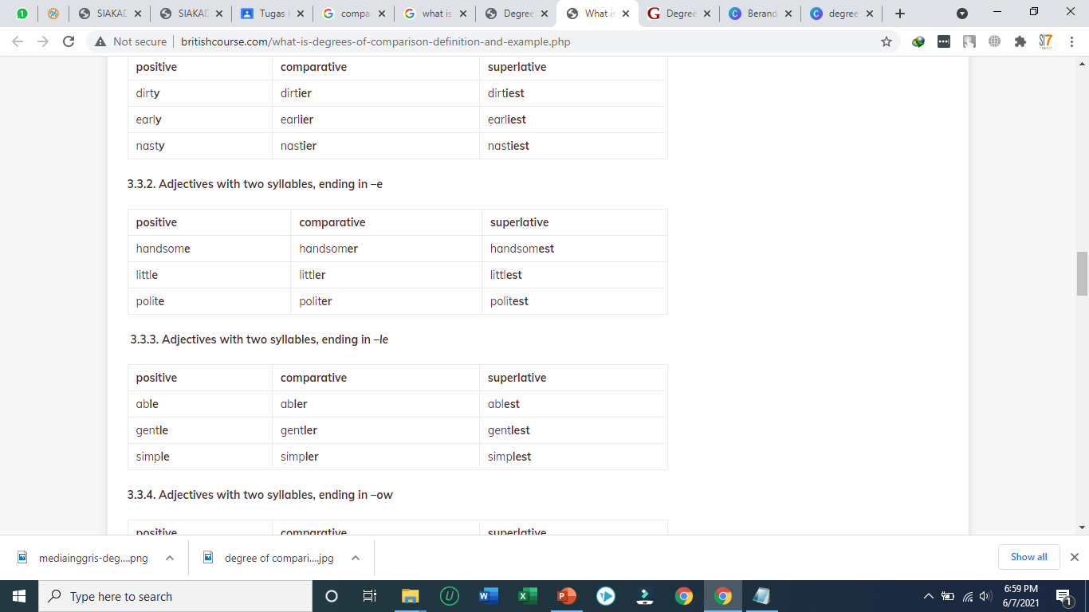
Adjectives with two syllables, ending in –e
Adjectives with two syllables, ending in –le

Slide 8
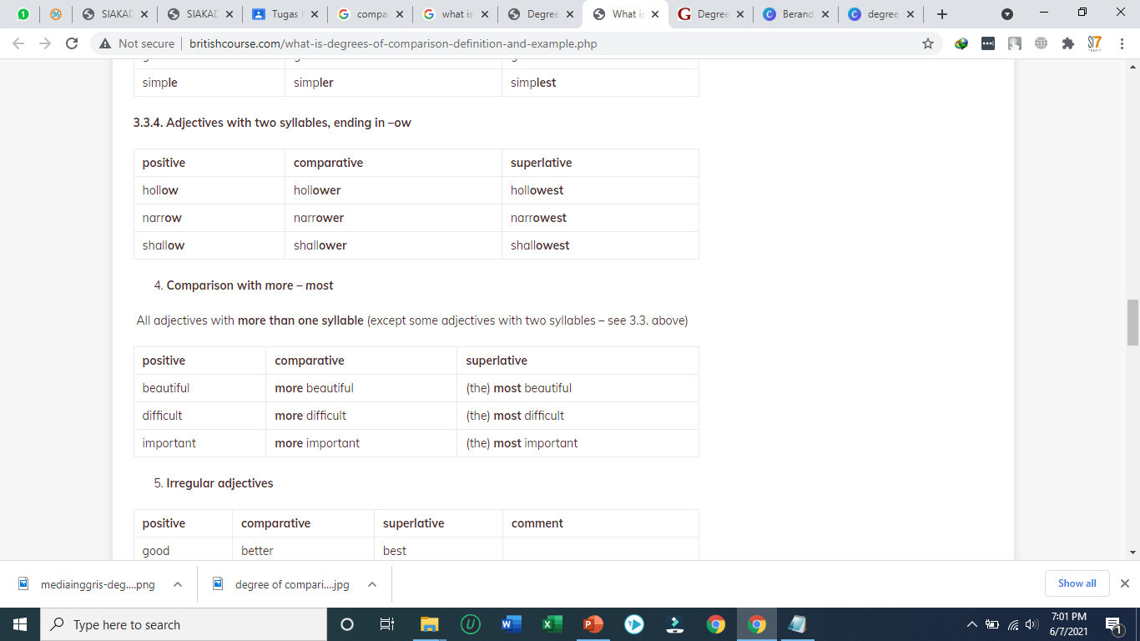
Adjectives with two syllables, ending in –ow
Comparison with more – most. All adjectives with more than one syllable

Slide 9
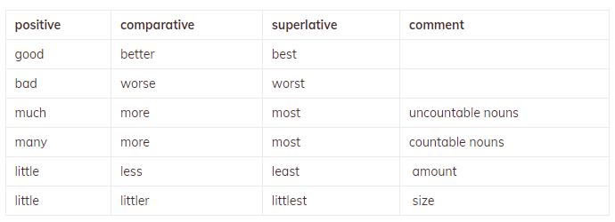
Irregular adjectives

